Slide 1
CSc 502 Web computing
Instructor: Bincy Ivin

Slide 2
Course Objectives
Orient Web Programming fundamental.
Expose to JavaScript to develop interactive web page development
Orient to Basics of REACT along with installation
Expose to node.js applications using express framework
Orient to Fundamentals of node.js
Expose to Advanced concepts in REACT

Slide 3

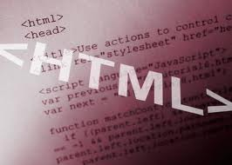

Course Objectives (cont.)
At the end of this class you will be able to:
Select protocols or technologies required for various web applications
Apply JavaScript to add functionality to web pages. .
Design front end application using basic React. .
Construct web based Node.js applications using Express
Design front end applications using functional components of React.
Design back-end applications using Node.js

Slide 4
Grading
Internal Assessment | 20 Marks
Theory | 80 Marks
Total | 100 Marks

Slide 5
What is the internet?
Notes:
Computer networks interconnected

Slide 6
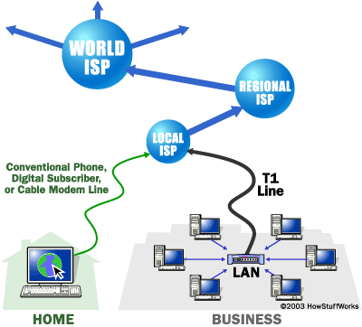
What is the internet?
Global network of billions of computers and other electronic devices that use a protocol to exchange data.
Possible to access almost any information, communicate with anyone else in the world, and do much more.
Notes:
Computer networks interconnected

Slide 7
Brief history
ARPANET was introduced in the year 1969 by Advanced Research Projects Agency (ARPA) of US Department of Defense.
ARPANET's main use was for academic and research purposes.
It was established using a bunch of PCs at various colleges and sharing of information and messages was done.
Packet switching Network
By 1987: Internet includes nearly 30,000 hosts
Notes:
The first ARPANET link was established between the University of California, Los Angeles and the Stanford Research Institute on 22:30 hours on October 29, 1969
Store and forward, i.e. packet switching
Usenet is a world-wide distributed discussion system. It consists of a set of "newsgroups" with names that are classified hierarchically by subject. "Articles" or "messages" are "posted" to these newsgroups by people on computers with the appropriate software -- these articles are then broadcast to other interconnected computer systems via a wide variety of networks. Some newsgroups are "moderated"; in these newsgroups, the articles are first sent to a moderator for approval before appearing in the newsgroup. Usenet is available on a wide variety of computer systems and networks, but the bulk of modern Usenet traffic is transported over either the Internet or UUCP.

Slide 8
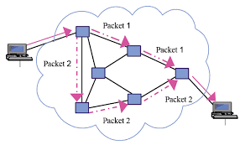
Brief history
Notes:
The first ARPANET link was established between the University of California, Los Angeles and the Stanford Research Institute on 22:30 hours on October 29, 1969
Store and forward, i.e. packet switching
Usenet is a world-wide distributed discussion system. It consists of a set of "newsgroups" with names that are classified hierarchically by subject. "Articles" or "messages" are "posted" to these newsgroups by people on computers with the appropriate software -- these articles are then broadcast to other interconnected computer systems via a wide variety of networks. Some newsgroups are "moderated"; in these newsgroups, the articles are first sent to a moderator for approval before appearing in the newsgroup. Usenet is available on a wide variety of computer systems and networks, but the bulk of modern Usenet traffic is transported over either the Internet or UUCP.

Slide 9
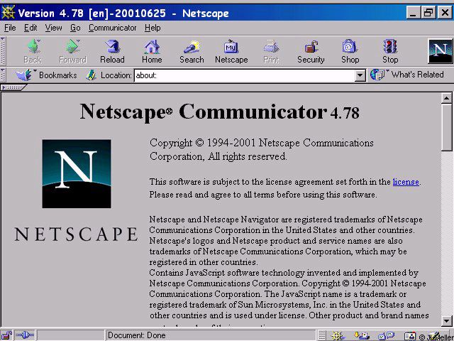
Brief history (cont.)
WWW created in 1989-91 by Tim Berners-Lee
Popular web browsers released:
Netscape 1994
IE 1995
Amazon.com opens in 1995
Google January 1996
Wikipedia launched in 2001
MySpace opens in 2003
Facebook February 2004

Slide 10
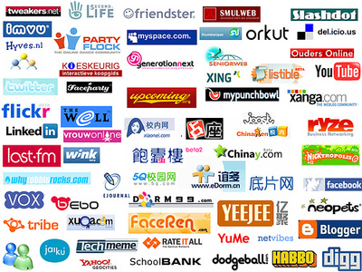
Wikipedia launched in 2001
MySpace opens in 2003
Facebook February 2004
Notes:
Which of these do you recognize?

Slide 11
Key aspects of the internet
Sub-networks are independent
Computers can dynamically join and leave the network
Built on open standards
Everyone can use it with simple, commonly available software
Notes:
; anyone can create a new internet device

Slide 12



People and organizations
Internet Engineering Task Force (IETF): internet protocol standards
Internet Corporation for Assigned Names and Numbers (ICANN): decides top-level domain names
World Wide Web Consortium (W3C): web standards

Slide 13
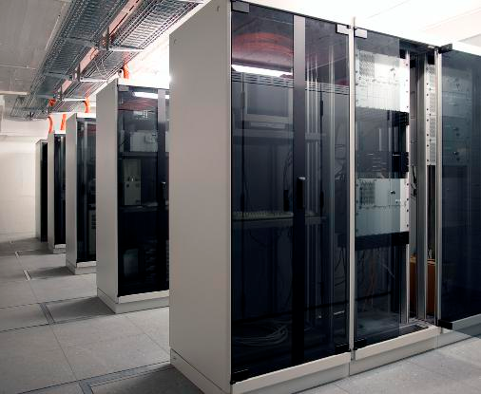

Web Servers
Web server: software that listens for web page requests
Apache
Microsoft Internet
Information Server (IIS)
Notes:
Normal computers, just more powerful
They run specialized SW

Slide 14




Application Server
Software framework that provides an environment where applications can run
Apache
Glassfish
WebSphere
WebLogic
Notes:
Taking a big step back, a Web server serves pages for viewing in a Web browser, while an application server provides methods that client applications can call. A little more precisely, you can say that:
A Web server exclusively handles HTTP requests, whereas an application server serves business logic to application programs through any number of protocols.

Slide 15
Web Browser
Type of software that allows you to find and view websites from web servers on the Internet.
Mozilla Firefox
Microsoft Internet Explorer (IE)
Apple Safari
Google Chrome
Opera
Notes:
Explorer pain

Slide 16
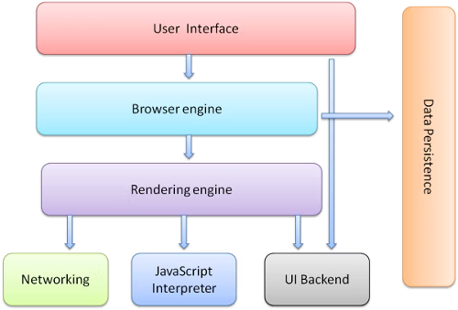
Web Browser
Notes:
Explorer pain

Slide 17
Web Browser
The user interface: this includes the address bar, back/forward button, bookmarking menu, etc. Every part of the browser display except the window where you see the requested page.
The browser engine: marshals actions between the UI and the rendering engine.
.he rendering engine: responsible for displaying requested content. For example if the requested content is HTML, the rendering engine parses HTML and CSS, and displays the parsed content on the screen.
Notes:
Explorer pain

Slide 18
Web Browser
Networking: for network calls such as HTTP requests, using different implementations for different platform behind a platform-independent interface.
UI backend: used for drawing basic widgets like combo boxes and windows. This backend exposes a generic interface that is not platform specific. Underneath it uses operating system user interface methods.
JavaScript interpreter. Used to parse and execute JavaScript code.
Data storage. This is a persistence layer. The browser may need to save all sorts of data locally, such as cookies. Browsers also support storage mechanisms such as localStorage, IndexedDB, WebSQL and FileSystem.
Notes:
Explorer pain

Slide 19
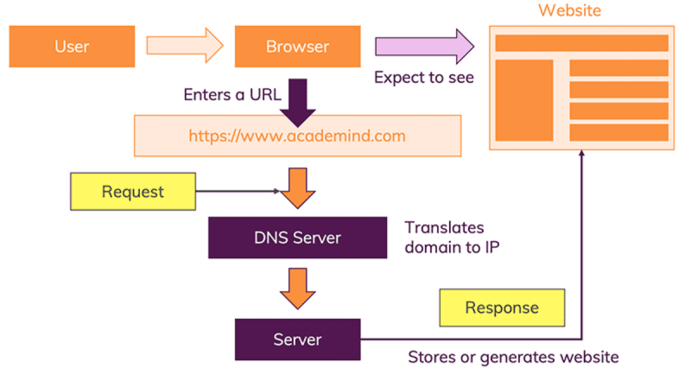

Slide 20
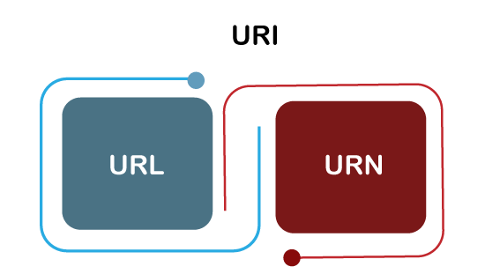
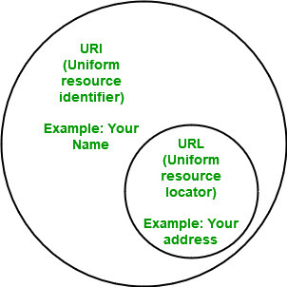
Uniform Resource Identifier (URI)

Slide 21
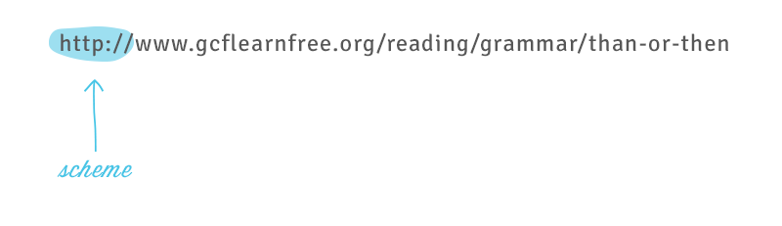
Uniform Resource Locator (URL)
Scheme:
Every URL begins with the Scheme.
tells your browser what type of address it is so the browser connects to it correctly.
http and https

Slide 22
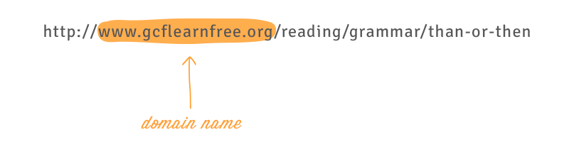
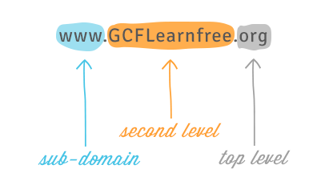
Uniform Resource Locator (URL)
Domain name:
The most prominent part of a web address.
Typically, different pages on the same site will continue to use the same domain name.

Slide 23
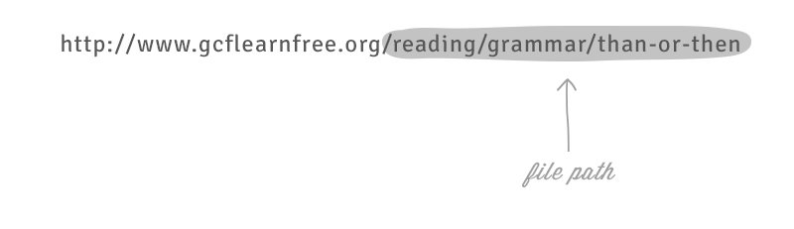
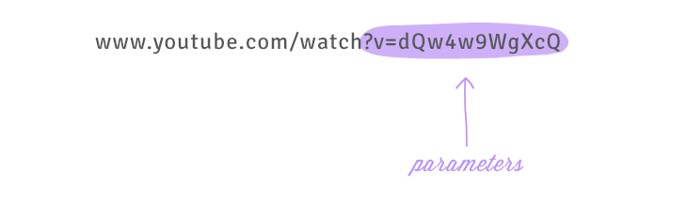
Uniform Resource Locator (URL)
File path:
often just called the path—tells your browser to load a specific page.
Parameters:
The parameter string can be clear or confusing to a human user, but it is critical information for the server.

Slide 24
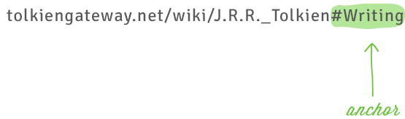
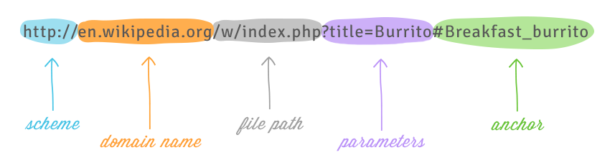
Uniform Resource Locator (URL)
Anchor
Tells your browser to scroll to or load a specific part of the page.
Begins with a hashtag and is used to direct your browser to a specific part of a very long page.
Like a bookmark.

Slide 25
Domain Name Server (DNS)
Step 1: URL Gets Resolved
The website code not stored on your machine and hence needs to be fetched from another computer where it is stored. This "other computer" is called a "server". Because it serves some purpose, in our case, it serves the website.
The server which hosts the source code of a website, is identified via IP addresses. The browser sends a "request" to the server with the IP address you entered.
Notes:
What happens when you have connection but cannot download a webpage??
Mapping between numbers and human readable addresses
Top level domains: .com, .org, countries

Slide 26
Domain Name Server (DNS)
Translates domains to IP addresses.
Huge dictionaries that store translation tables: Domain => IP address.
Example: ju.edu → 204.29.160.73
Many systems maintain a local cache called a hosts file
Windows: C:\Windows\system32\drivers\etc\hosts
Mac: /private/etc/hosts
Linux: /etc/hosts
Notes:
What happens when you have connection but cannot download a webpage??
Mapping between numbers and human readable addresses
Top level domains: .com, .org, countries

Slide 27
Hypertext Transport Protocol (HTTP)
Step 2 - Request Is Sent
With the IP address resolved, the browser goes ahead and makes a request to the server with that IP address.
The browser bundles up a bunch of information (What's the exact URL? Which kind of request should be made? Should metadata be attached) and sends that data package to the IP address.
Notes:
telnet ju.edu
GET index.html
http is stateless

Slide 28
Hypertext Transport Protocol (HTTP)
HTTP stands for HyperText Transfer Protocol.
Invented by Tim Berner.
Type of text which is specially coded with the help of some standard coding language called as HyperText Markup Language (HTML).
HTTP/2 is latest version of HTTP, which was published on May 2015.
The protocols that are used to transfer hypertext between two computers is known as HyperText Transfer Protocol.
HTTP provides standard between a web browser and web server to establish communication.
Set of rules for transferring data from one computer to another.
Notes:
telnet ju.edu
GET index.html
http is stateless

Slide 29
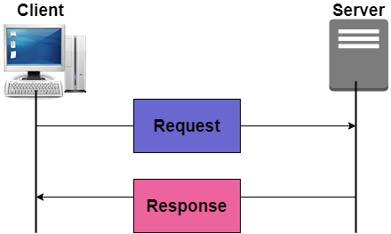
Hypertext Transport Protocol (HTTP)
HTTP requests:
An HTTP request is made by a client, to a named host, which is located on a server. The aim of the request is to access a resource on the server.
HTTP responses:
An HTTP response is made by a server to a client. The aim of the response is to provide the client with the resource it requested, or inform the client that the action it requested has been carried out; or else to inform the client that an error occurred in processing its request.
Notes:
telnet ju.edu
GET index.html
http is stateless

Slide 30
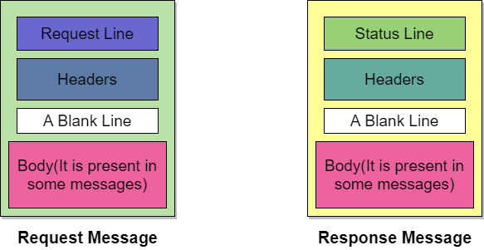
Hypertext Transport Protocol (HTTP)
Notes:
telnet ju.edu
GET index.html
http is stateless

Slide 31
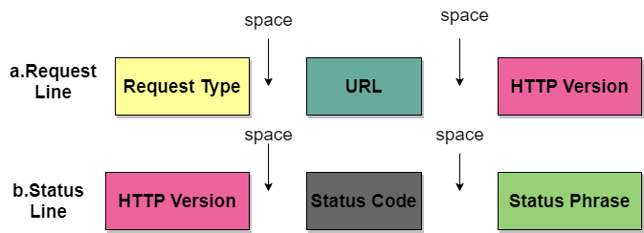

Slide 32
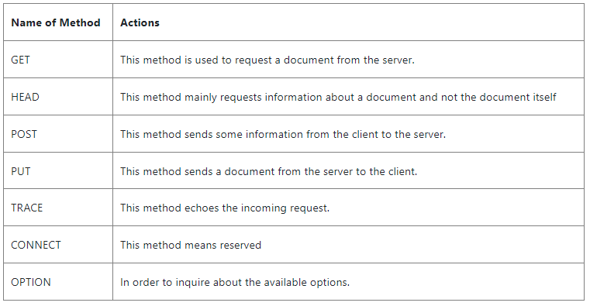
Hypertext Transport Protocol (HTTP)
Notes:
telnet ju.edu
GET index.html
http is stateless

Slide 33
Hypertext Transport Protocol (HTTP)
A status code, indicating if the request was successful or not, and why.
A status message, a non-authoritative short description of the status code.
Optionally, a body containing the fetched resource.
Notes:
telnet ju.edu
GET index.html
http is stateless

Slide 34
Hypertext Transport Protocol (HTTP)
Header
The header is used to exchange the additional information between the client and the server. The header mainly consists of one or more header lines. Each header line has a header name, a colon, space, and a header value.
Notes:
telnet ju.edu
GET index.html
http is stateless

Slide 35
Hypertext Transport Protocol (HTTP)
The header line is further categorized into four:
General Header: It provides general information about the message and it can be present in both request and response.
Request Header: It is only present in the request message and is used to specify the configuration of the client and the format of the document preferred by the client
Response Header: This header is only present in the response header and mainly specifies the configuration of the server and also the special information about the request.
Entity Header: It is used to provide information about the body of the document.
Notes:
telnet ju.edu
GET index.html
http is stateless

Slide 36
Hypertext Transport Protocol (HTTP)
Exercise: simulate a browser with a terminal window
Notes:
telnet ju.edu
GET index.html
http is stateless

Slide 37
HTTP Error Codes
When something goes wrong, the web server returns a special "error code" number
Common error codes:
Number | Meaning
200 | OK
301-303 | page has moved (permanently or temporarily)
403 | you are forbidden to access this page
404 | page not found
500 | internal server error

Slide 38
Internet Media (“MIME”) types
MIME type | file extension
text/html | .html
text/plain | .txt
image/gif | .gif
image/jpeg | .jpg
video/quicktime | .mov
application/octet-stream | .exe
Notes:
Sometimes when including resources in a page (style sheet, icon, multimedia object), we specify their type of data

Slide 39
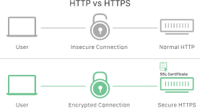
HTTP vs HTTPS

Slide 40
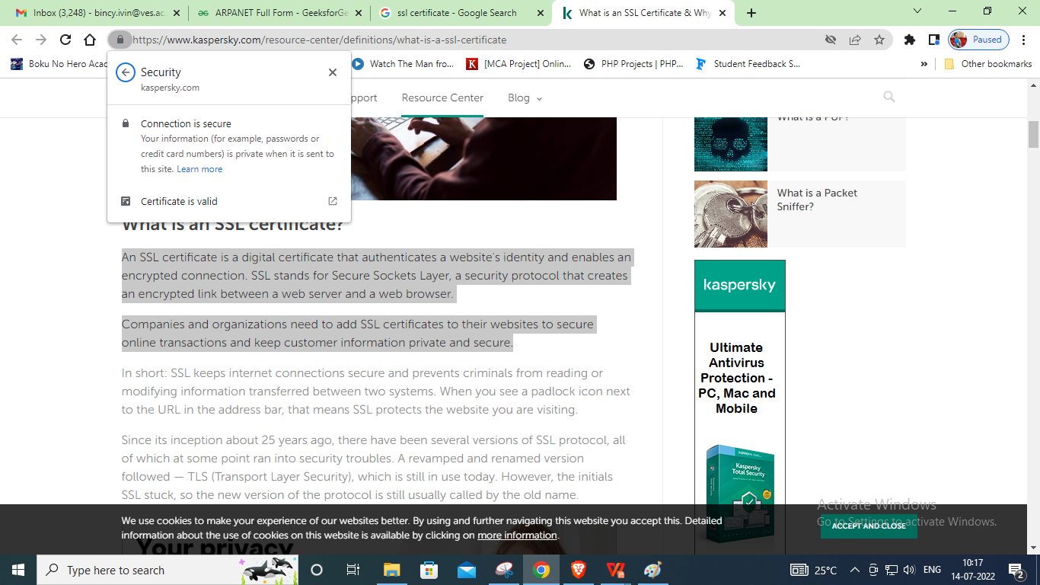
SSL- SECURE SOCKET LAYER
An SSL certificate is a digital certificate that authenticates a website's identity and enables an encrypted connection. SSL stands for Secure Sockets Layer, a security protocol that creates an encrypted link between a web server and a web browser.

Slide 41
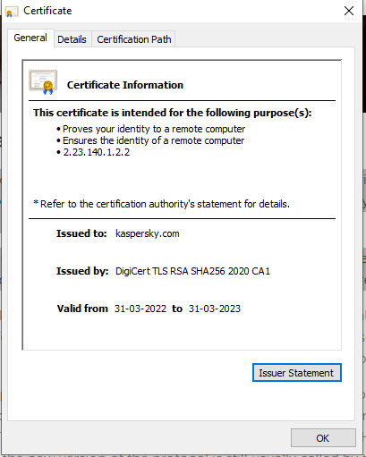
SSL- SECURE SOCKET LAYER
Companies and organizations need to add SSL certificates to their websites to secure online transactions and keep customer information private and secure.

Slide 42
SSL- SECURE SOCKET LAYER
The following steps are involved in the standard SSL handshake:
Client Hello: Server communicates with the client using SSL. This includes the SSL version number, cipher settings, and session-specific data.
Server Hello: The server responds with a “server hello” message. This includes the server’s SSL version number, cipher settings, session-specific data, an SSL certificate with a public key, and other information that the client needs to communicate with the server over SSL.
Authentication: The client verifies the server’s SSL certificate from the CA (Certificate Authority) and authenticates the server. If the authentication fails, then the client refuses the SSL connection and throws an exception. If the authentication succeeds, then they proceed to the next step.

Slide 43
SSL- SECURE SOCKET LAYER
Decryption: The client creates a session key, encrypts it with the server’s public key and sends it to the server.If the server has requested client authentication (mostly in server to server communication), then the client sends their own certificate to the server.
Encryption with Session Key: The server decrypts the session key with its private key and sends the acknowledgement to the client encrypted with the session key.
Thus, at the end of the SSL handshake, both the client and the server have a valid session key which they will use to encrypt or decrypt the original data.

Slide 44
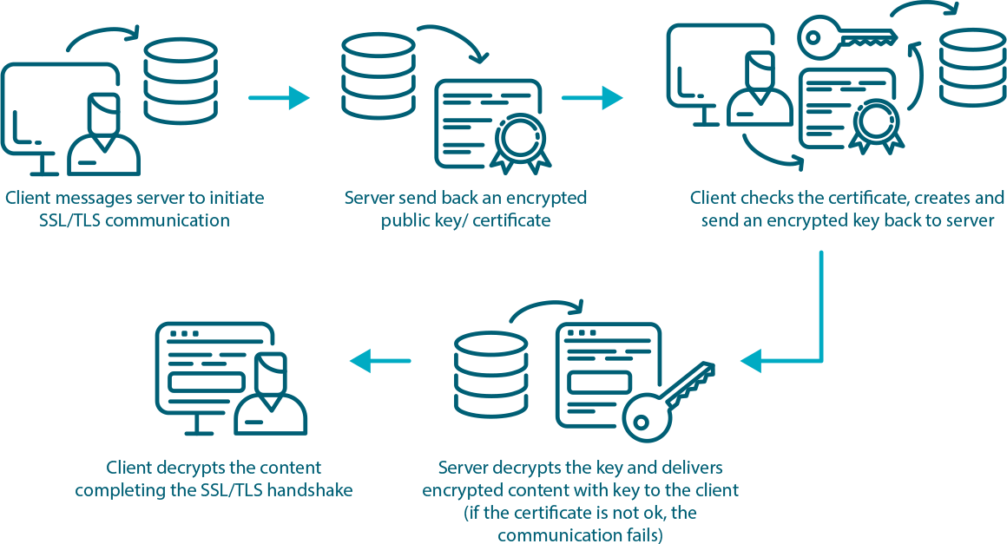
TLS- Transport Layer Security

Slide 45
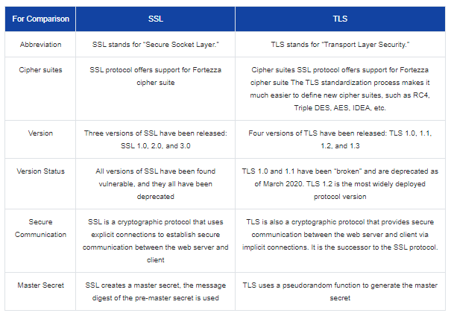
TLS- Transport Layer Security

Slide 46
Parameter | HTTP | HTTPS
Protocol | It is hypertext transfer protocol. | It is hypertext transfer protocol with secure.
Security | It is less secure as the data can be vulnerable to hackers. | It is designed to prevent hackers from accessing critical information. It is secure against such attacks.
Port | It uses port 80 by default | It was use port 443 by default.
Starts with | HTTP URLs begin with http:// | HTTPs URLs begin with https://
Used for | It’s a good fit for websites designed for information consumption like blogs. | If the website needs to collect the private information such as credit card number, then it is a more secure protocol.
Scrambling | HTTP does not scramble the data to be transmitted. That’s why there is a higher chance that transmitted information is available to hackers. | HTTPS scrambles the data before transmission. At the receiver end, it descrambles to recover the original data. Therefore, the transmitted information is secure which can’t be hacked.
Protocol | It operates at level. | HTTPS does not have any separate protocol. It operates using HTTP but uses encrypted TLS/SSL connection.
Domain Name Validation | HTTP website do not need SSL. | HTTPS requires SSL certificate.
Data encryption | HTTP website doesn’t use encryption. | HTTPS websites use data encryption.
Search Ranking | HTTP does not improve search rankings. | HTTPS helps to improve search ranking.
Speed | Fast | Slower than HTTP
Vulnerability | Vulnerable to hackers | It Is highly secure as the data is encrypted before it is seen across a network.

Slide 47
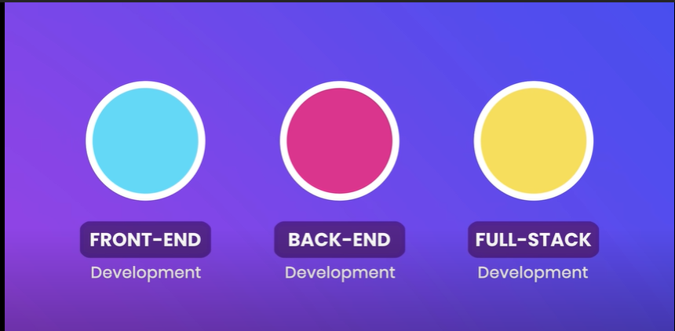

Slide 48
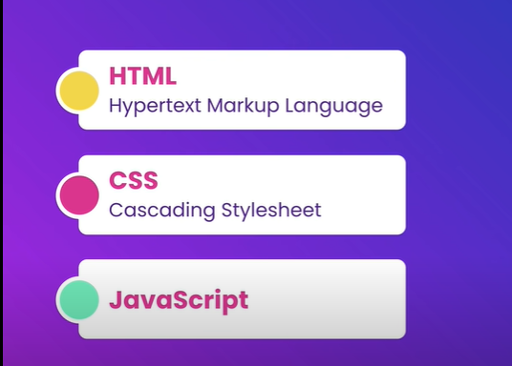

Slide 49


Slide 50


Slide 51


Slide 52
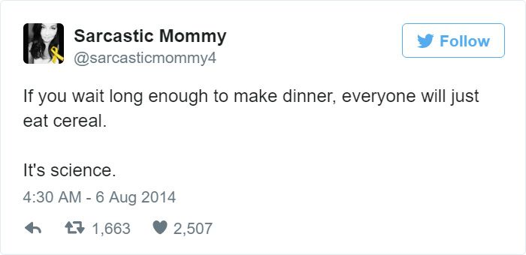

Slide 53
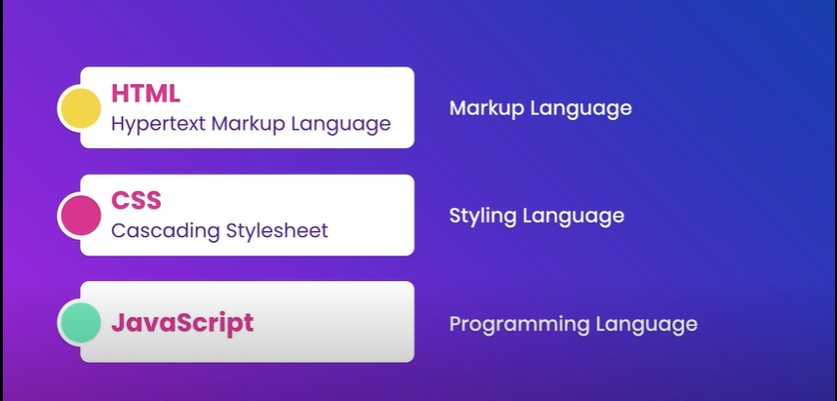

Slide 54


Slide 55
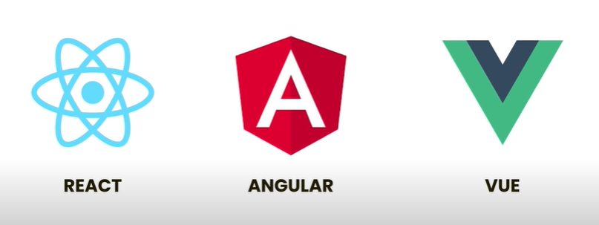

Slide 56


Slide 57


Slide 58
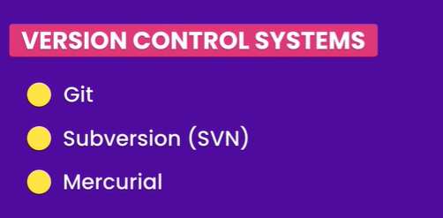

Slide 59
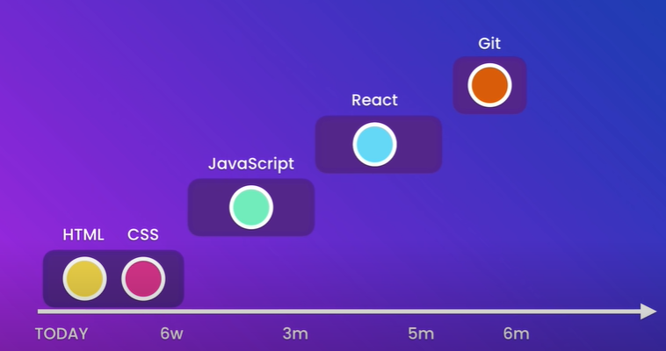

Slide 60
HTML
HTML: HTML (Hyper Text Markup Language) is used to create web pages and web applications. It is a markup language. By HTML we can create our own static page.
It is used for displaying the data not to transport the data.
HTML is the combination of Hypertext and Markup language. Hypertext defines the link between the web pages.
A markup language is used to define the text document within tag which defines the structure of web pages. This language is used to annotate (make notes for the computer) text so that a machine can understand it and manipulate text accordingly.

Slide 61
HTML
<!DOCTYPE html>
<html>
<head>
<title>This is document title</title>
</head>
<body>
<h1>This is a heading</h1>
<p>Document content goes here.....</p>
</body>
</html>

Slide 62
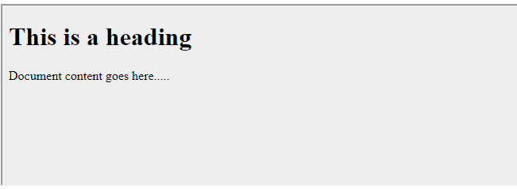
HTML

Slide 63
HTML
Web pages development - HTML is used to create pages which are rendered over the web. Almost every page of web is having html tags in it to render its details in browser.
Internet Navigation - HTML provides tags which are used to navigate from one page to another and is heavily used in internet navigation.
Responsive UI - HTML pages now-a-days works well on all platform, mobile, tabs, desktop or laptops owing to responsive design strategy.
Offline support HTML pages once loaded can be made available offline on the machine without any need of internet.
Game development- HTML5 has native support for rich experience and is now useful in gaming developent arena as well.

Slide 64
Web Languages: XML
1.HTML is defined to describe the general form and layout of information in web documents without considering its meaning of the information.
To describe a particular kind of information, it would be necessary to have tags indicating the meaning of the element’s content. That would allow the processing of specific categories of information in a document.

Slide 65
Web Languages: XML
2. HTML defines fixed set of tags and attributes. Given tags must fit every kind of document.
3. There are no restrictions on arrangement or order of tag appearance in HTML document. For example, an
opening tag can appear in the content of an element, but its corresponding closing tag can appear after the
end of the element in which it is nested.
Eg : <strong> Now <em> is </strong> the time </em>

Slide 66
Web Languages: XML
XML stands for Extensible Markup Language and is a text-based markup language
A markup language is a set of codes, or tags, that describes the text in a digital document.
The most famous markup language is hypertext markup language (HTML), which is used to format Web pages. XML, a more flexible cousin of HTML, makes it possible to conduct complex business over the Internet.

Slide 67
Web Languages: XML
The Difference between XML and HTML
XML and HTML were designed with different goals:
XML was designed to carry data - with focus on what data is
HTML was designed to display data - with focus on how data looks
XML tags are not predefined like HTML tags
XML documents form a tree structure that starts at "the root" and branches to "the leaves".

Slide 68
Web Languages: XML
HTML includes a collection of predefined tags that you can use right away in editingyour HTML files, e.g. <font> and <h1>, but XML tags are not predefined.
To use XML, users have to define their own tags for their specific application before using them. For example, to describe a note, <note>, <to>, <from>, <heading>, and <body>are defined in advance and used in a nested fashion to present the following XML file asa note:
<note>
<to>Tove</to>
<from>Jani</from>
<heading>Reminder</heading>
<body>Don’t forget the party!</body>
</note>

Slide 69
Web Languages: XML
With XML, it is illegal to omit the closing tag.
In HTML some elements do not have to have a closing tag to be able to present content
in the way the user wants them to. For example:
<p>This is a paragraph
<p>This is another paragraph
In XML, however, all elements must have a closing tag, like this:
<p>This is a paragraph</p>
<p>This is another paragraph</p>

Slide 70
Web Languages: XML
Unlike HTML, XML tags are case sensitive.
With XML, the tag <Letter> is different from the tag <letter>.
Opening and closing tags must therefore be written with the same case:
<Message>This is incorrect</message>
<message>This is correct</message>
Improper nesting of tags makes no sense to XML.
In HTML some elements can be improperly nested within each other and still display content in the desired way like this:
<b><i>This text is bold and italic</b></i>
In XML all elements must be properly nested within each other like this:
<b><i>This text is bold and italic</i></b>

Slide 71
Web Languages: XML
All XML documents must contain a single tag pair to define a root element.
All other elements must be within this root element. All elements can have sub elements(child elements). Sub elements must be correctly nested within their parent element:
<root>
<child>
<subchild>.....</subchild>
</child>
</root>

Slide 72
Web Languages: XML
With XML, it is illegal to omit quotation marks around attribute values. XML elements can have attributes in name/value pairs just like in HTML. In XML theattribute value must always be quoted. Study the two XML documents below.
<?xml version="1.0" encoding="ISO-8859-1"?>
<note date=12/11/2002>
<to>Tove</to>
<from>Jani</from>
</note>
<?xml version="1.0" encoding="ISO-8859-1"?>
<note date="12/11/2002">
<to>Tove</to>
<from>Jani</from>
</note>

Slide 73
Web Languages: XML
There is no length limitation for names.
Space is Preserved in XML
HTML truncates multiple white-space characters to one single white-space: With XML, the whitespace in a document is not truncated
Comments in XML are same as HTML <!-- This is a comment -->
XML names must begin with a letter or underscore and can include digits, hyphens, and periods.

Slide 74
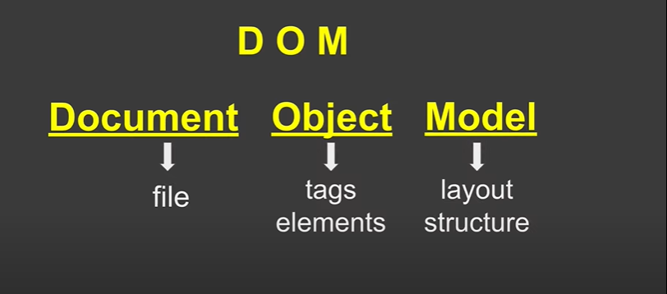
Document Object Model: DOM

Slide 75
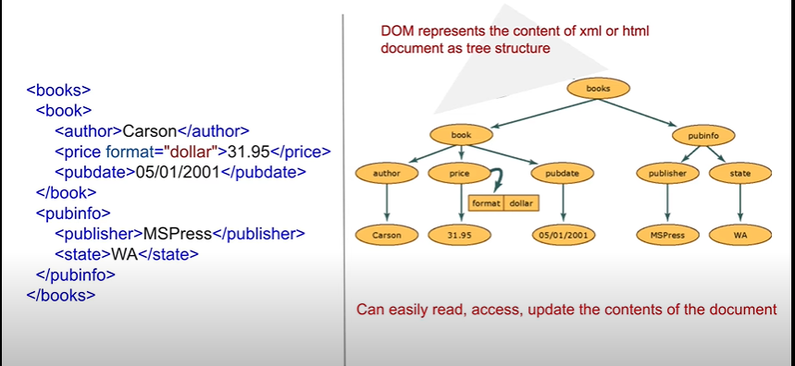
Document Object Model: DOM

Slide 76
Document Object Model: DOM
DOM is a way to represent the webpage in a structured hierarchical way so that it will become easier for programmers and users to glide through the document.
With DOM, we can easily access and manipulate tags, IDs, classes, Attributes, or Elements of HTML using commands or methods provided by the Document object.
Using DOM, the JavaScript gets access to HTML as well as CSS of the web page and can also add behavior to the HTML elements. so basically Document Object Model is an API that represents and interacts with HTML or XML documents.

Slide 77
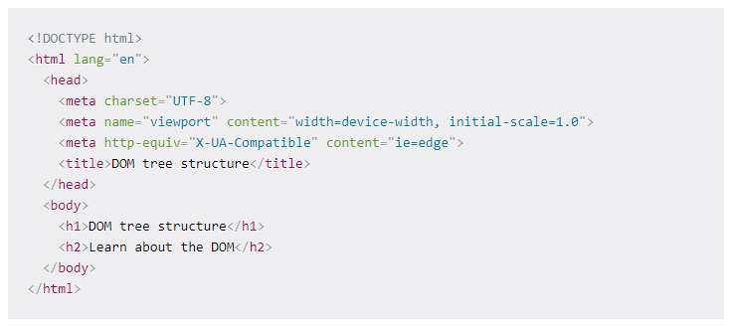
Document Object Model: DOM

Slide 78
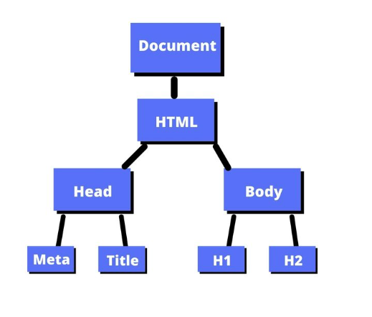
Document Object Model: DOM

Slide 79
How to Select Elements in the Document
getElementById()
querySelector()
querySelectorAll()

Slide 80
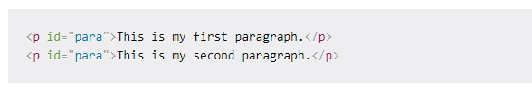
How to Select Elements in the Document
getElementById()
In HTML, ids are used as unique identifiers for the HTML elements. This means you cannot have the same id name for two different elements.
This would be incorrect:

Slide 81
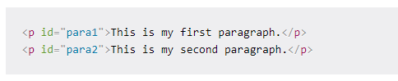
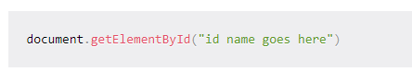
How to Select Elements in the Document
You would have to make sure those ids are unique like this:
In JavaScript, we can grab an HTML tag by referencing the id name.

Slide 82
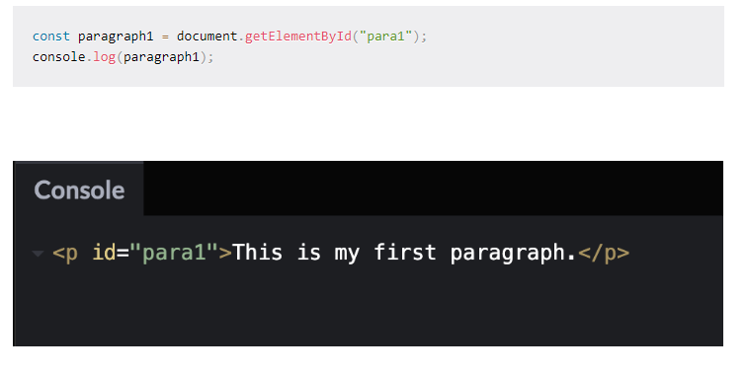
How to Select Elements in the Document
This code tells the computer to get the <p> element with the id of para1 and print the element to the console.

Slide 83
JavaScript Object Notation JSON
JSON stands for JavaScript Object Notation.
JSON is an open standard data-interchange format.
JSON is lightweight and self-describing.
JSON originated from JavaScript.
JSON is easy to read and write.
JSON is language independent.
JSON supports data structures such as arrays and objects.

Slide 84
JavaScript Object Notation JSON
Less Verbose: In contrast to XML, JSON follows a compact style to improve its users' readability. While working with a complex system, JSON tends to make substantial enhancements.
Faster: The JSON parsing process is faster than that of the XML because the DOM manipulation library in XML requires extra memory for handling large XML files. However, JSON requires less data that ultimately results in reducing the cost and increasing the parsing speed.
Readable: The JSON structure is easily readable and straightforward. Regardless of the programming language that you are using, you can easily map the domain objects.
Structured Data: In JSON, a map data structure is used, whereas XML follows a tree structure. The key-value pairs limit the task but facilitate the predictive and easily understandable model.

Slide 85
JavaScript Object Notation JSON
Basic data types supported by json are:
Strings: Characters that are enclosed in single or double quotation marks.
Number: A number could be integer or decimal, positive or negative.
Booleans: The Boolean value could be either true or false without any quotation marks.
Null: Here, null means nothing without any quotation marks.

Slide 86
JavaScript Object Notation JSON
Arrays
Arrays are the lists that are represented by the square brackets, and the values have commas in between them. They can contain mix data types, i.e., a single array can have strings, Boolean, numbers.
For example:
Example 1: [1, 2, 7.8, 5, 9, 10];
Example 2: ["red", "yellow", "green"];
Example 3: [8, "hello", null, true];
In the above, example 1 is an array of numbers, example 2 is an array of strings, and example 3 is an array of mix data types.

Slide 87
JavaScript Object Notation JSON
Objects
Objects are JSON dictionaries that are enclosed in curly brackets. In objects, keys and values are separated by a colon ':', pairs are separated by comma. Keys and values can be of any type, but the most common type for the keys is a string.
For example: {"red" : 1, "yellow" : 2, "green" : 3};

Slide 88
JavaScript Object Notation JSON
Nesting: Nesting involves keeping the arrays and objects inside of each other. We can put the arrays inside objects, objects inside arrays, arrays inside arrays, etc. We can say that json file is a big object with lots of objects and arrays inside. Example:
{
"song" :
{
"title" : "Hey Dude";
"artist": "The Beatles";
"musicians": ["John Lennon", "Paul McCratney", "Ringo Starr"];
}
}
In the above code, the song starts with a curly bracket. Therefore, a song is an object. It contains three key-value pairs wherein title, artist and musicians are the keys.'

Slide 89
JavaScript Object Notation JSON
Nesting: Nesting involves keeping the arrays and objects inside of each other. We can put the arrays inside objects, objects inside arrays, arrays inside arrays, etc. We can say that json file is a big object with lots of objects and arrays inside. Example:
{
"song" :
{
"title" : "Hey Dude";
"artist": "The Beatles";
"musicians": ["John Lennon", "Paul McCratney", "Ringo Starr"];
}
}
In the above code, the song starts with a curly bracket. Therefore, a song is an object. It contains three key-value pairs wherein title, artist and musicians are the keys.'

Slide 90
JavaScript Object Notation JSON
In JSON, objects refer to dictionaries, which are enclosed in curly brackets, i.e., { }. These objects are written in key/value pairs, where the key has to be a string and values have to be a valid JSON data type such as string, number, object, Boolean or null. Here the key and values are separated by a colon, and a comma separates each key/value pair.
For example:
{"name" : "Jack", "employeeid" : 001, "present" : false}

Slide 91
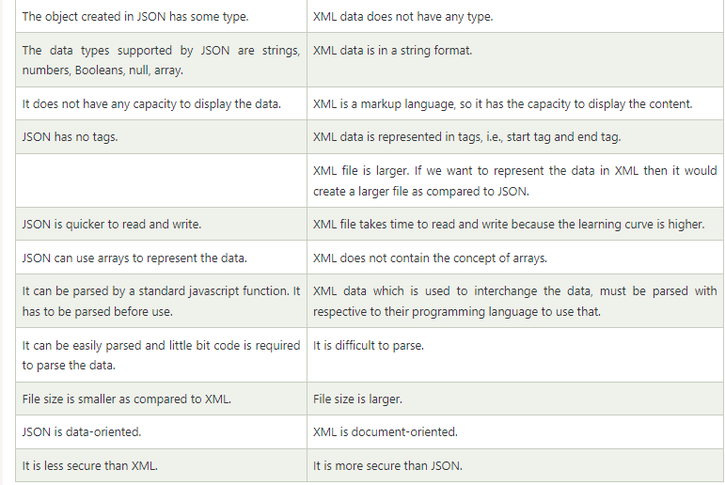
JavaScript Object Notation JSON

Slide 92
JavaScript Object Notation JSON
{"employees":[
{"name":"Shyam", "email":"shyamjaiswal@gmail.com"},
{"name":"Bob", "email":"bob32@gmail.com"},
{"name":"Jai", "email":"jai87@gmail.com"}
]}

Slide 93
JavaScript Object Notation JSON
<employees>
<employee>
<name>Shyam</name>
<email>shyamjaiswal@gmail.com</email>
</employee>
<employee>
<name>Bob</name>
<email>bob32@gmail.com</email>
</employee>
<employee>
<name>Jai</name>
<email>jai87@gmail.com</email>
</employee>
</employees>

Slide 94
JavaScript Object Notation JSON
<employees>
<employee>
<name>Shyam</name>
<email>shyamjaiswal@gmail.com</email>
</employee>
<employee>
<name>Bob</name>
<email>bob32@gmail.com</email>
</employee>
<employee>
<name>Jai</name>
<email>jai87@gmail.com</email>
</employee>
</employees>

Slide 95
JavaScript Object Notation JSON
JSON Object : JSON object holds key/value pair. Each key is represented as a string in JSON and value can be of any type. The keys and values are separated by colon. Each key/value pair is separated by comma.
The curly brace { represents JSON object.
{
"employee": {
"name": "sonoo",
"salary": 56000,
"married": true
}
}
In the above example, employee is an object in which "name", "salary" and "married" are the key. In this example, there are string, number and boolean value for the keys.

Slide 96
JavaScript Object Notation JSON
JSON Object with Strings
The string value must be enclosed within double quote.
{
"name": "sonoo",
"email": "sonoojaiswal1987@gmail.com"
}

Slide 97
JavaScript Object Notation JSON
JSON Object with Numbers
JSON supports numbers in double precision floating-point format. The number can be digits (0-9), fractions (.33, .532 etc) and exponents (e, e+, e-,E, E+, E-).
{
"integer": 34,
"fraction": .2145,
"exponent": 6.61789e+0
}

Slide 98
JavaScript Object Notation JSON
JSON Object with Booleans
JSON also supports boolean values true or false.
{
"first": true,
"second": false
}

Slide 99
JavaScript Object Notation JSON
JSON Nested Object Example
A JSON object can have another object also.
{
"firstName": "Sonoo",
"lastName": "Jaiswal",
"age": 27,
"address" : {
"streetAddress": "Plot-6, Mohan Nagar",
"city": "Ghaziabad",
"state": "UP",
"postalCode": "201007"
}
}

Slide 100
JavaScript Object Notation JSON
JSON Array
JSON array represents ordered list of values. JSON array can store multiple values. It can store string, number, boolean or object in JSON array.
In JSON array, values must be separated by comma.
The [ (square bracket) represents JSON array.

Slide 101
JavaScript Object Notation JSON
JSON Array of Strings
["Sunday", "Monday", "Tuesday", "Wednesday", "Thursday", "Friday", "Saturday"]
JSON Array of Numbers
[12, 34, 56, 43, 95]
JSON Array of Booleans
[true, true, false, false, true]
JSON Array of Objects
{"employees":[
{"name":"Ram", "email":"ram@gmail.com", "age":23},
{"name":"Shyam", "email":"shyam23@gmail.com", "age":28},
{"name":"John", "email":"john@gmail.com", "age":33},
{"name":"Bob", "email":"bob32@gmail.com", "age":41}
]}

Slide 102
JavaScript Object Notation JSON
JSON Multidimensional Array
We can store array inside JSON array, it is known as array of arrays or multidimensional array.
[
[ "a", "b", "c" ],
[ "m", "n", "o" ],
[ "x", "y", "z" ]
]

Slide 103
JavaScript Object Notation JSON
JSON Comments
JSON doesn't support comments. It is not a standard.
But you can do some tricks such as adding extra attribute for comment in JSON object, for example:
{
"employee": {
"name": "Bob",
"salary": 56000,
"comments": "He is a nice man"
}
}
Here, "comments" attribute can be treated as comment.

Slide 104
JavaScript Object Notation JSON
JSON Comments
JSON doesn't support comments. It is not a standard.
But you can do some tricks such as adding extra attribute for comment in JSON object, for example:
{
"employee": {
"name": "Bob",
"salary": 56000,
"comments": "He is a nice man"
}
}
Here, "comments" attribute can be treated as comment.

Slide 105
REST API
RESTful API is an interface that two computer systems use to exchange information securely over the internet.
An application programming interface (API) defines the rules that you must follow to communicate with other software systems. Developers expose or create APIs so that other applications can communicate with their applications programmatically.
Representational State Transfer (REST) is a software architecture that imposes conditions on how an API should work. REST was initially created as a guideline to manage communication on a complex network like the internet. You can use REST-based architecture to support high-performing and reliable communication at scale. You can easily implement and modify it, bringing visibility and cross-platform portability to any API system.
API developers can design APIs using several different architectures. APIs that follow the REST architectural style are called REST APIs. Web services that implement REST architecture are called RESTful web services.

Slide 106
Uniform interface
The uniform interface is fundamental to the design of any RESTful webservice. It indicates that the server transfers information in a standard format. The formatted resource is called a representation in REST. This format can be different from the internal representation of the resource on the server application. For example, the server can store data as text but send it in an HTML representation format.
Uniform interface imposes four architectural constraints: Requests should identify resources. They do so by using a uniform resource identifier.
Clients have enough information in the resource representation to modify or delete the resource if they want to. The server meets this condition by sending metadata that describes the resource further.
Clients receive information about how to process the representation further. The server achieves this by sending self-descriptive messages that contain metadata about how the client can best use them.
Clients receive information about all other related resources they need to complete a task. The server achieves this by sending hyperlinks in the representation so that clients can dynamically discover more resources.

Slide 107
Statelessness
In REST architecture, statelessness refers to a communication method in which the server completes every client request independently of all previous requests. Clients can request resources in any order, and every request is stateless or isolated from other requests. This REST API design constraint implies that the server can completely understand and fulfill the request every time.

Slide 108
Layered system
In a layered system architecture, the client can connect to other authorized intermediaries between the client and server, and it will still receive responses from the server. Servers can also pass on requests to other servers. You can design your RESTful web service to run on several servers with multiple layers such as security, application, and business logic, working together to fulfill client requests. These layers remain invisible to the client.

Slide 109
Cacheability
RESTful web services support caching, which is the process of storing some responses on the client or on an intermediary to improve server response time. For example, suppose that you visit a website that has common header and footer images on every page. Every time you visit a new website page, the server must resend the same images. To avoid this, the client caches or stores these images after the first response and then uses the images directly from the cache. RESTful web services control caching by using API responses that define themselves as cacheable or noncacheable.

Slide 110
Code on demand
In REST architectural style, servers can temporarily extend or customize client functionality by transferring software programming code to the client. For example, when you fill a registration form on any website, your browser immediately highlights any mistakes you make, such as incorrect phone numbers. It can do this because of the code sent by the server.

Slide 111
Code on demand
The general steps for any REST API call:
The client sends a request to the server. The client follows the API documentation to format the request in a way that the server understands.
The server authenticates the client and confirms that the client has the right to make that request.
The server receives the request and processes it internally.
The server returns a response to the client. The response contains information that tells the client whether the request was successful. The response also includes any information that the client requested.

Slide 112
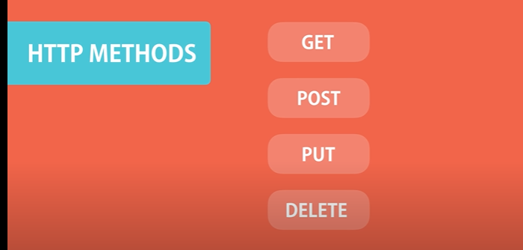
Code on demand

Slide 113
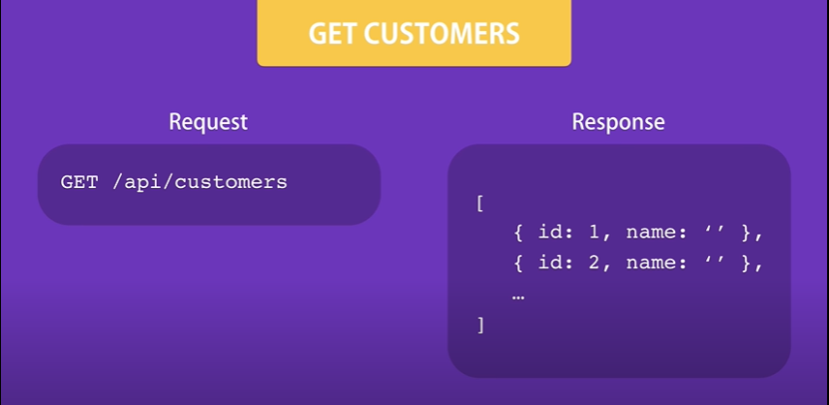
Code on demand

Slide 114
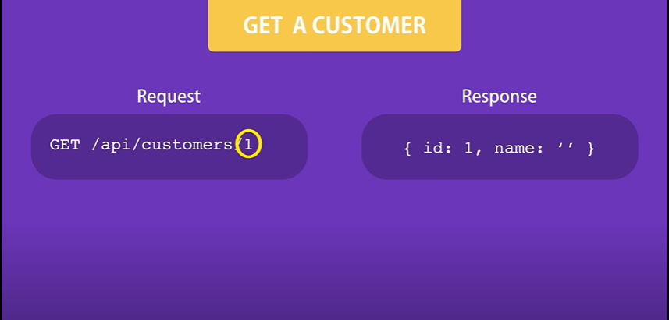
Code on demand

Slide 115
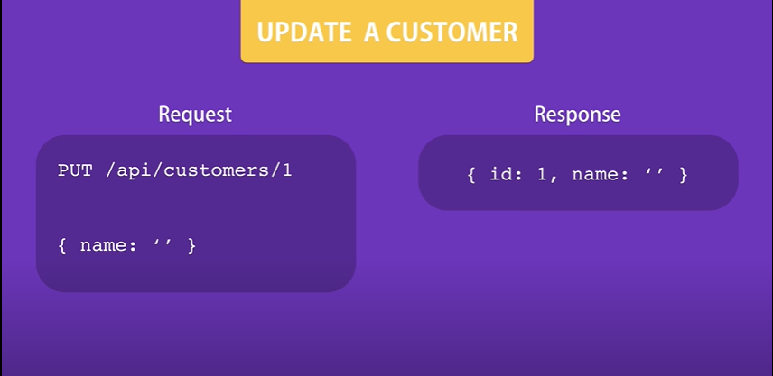
Code on demand

Slide 116
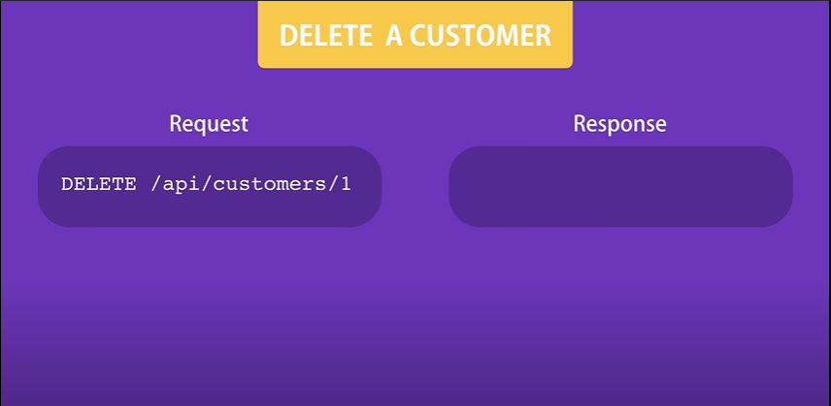
Code on demand

Slide 117
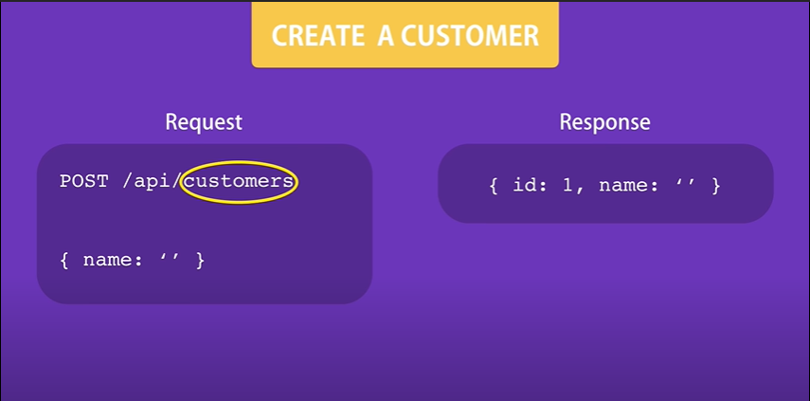
Code on demand

